Slide 1
Plankton Image Recognition Group 11 M102040016李翊瑄 M102040010許育禎

Slide 2
Content
Introduction
Data Preprocessing and Splitting
Models
Insight and Future Work

Slide 3
Introduction
1

Slide 4
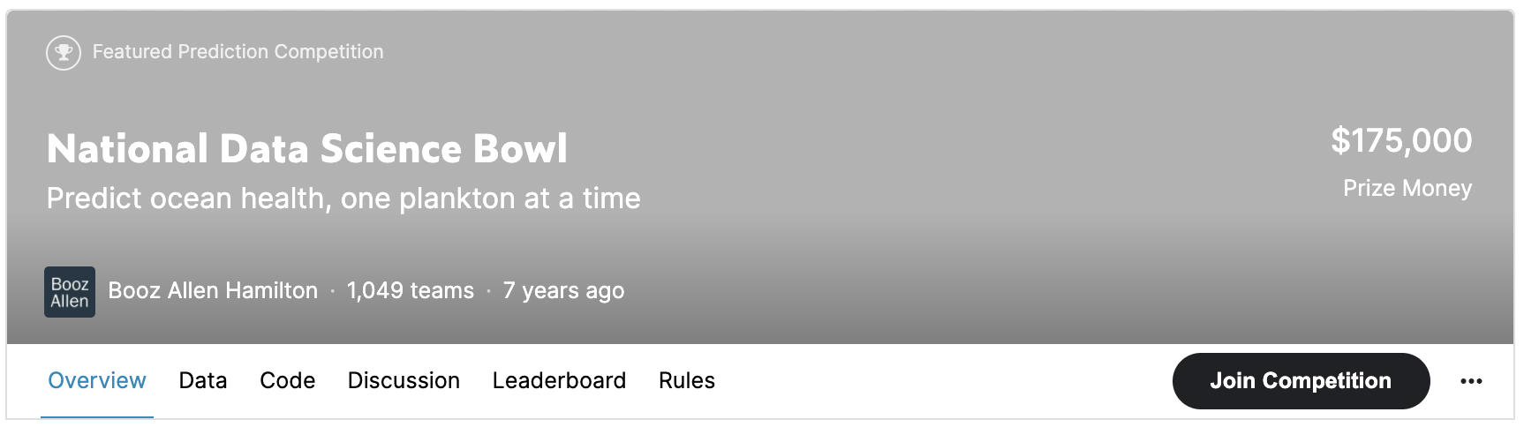
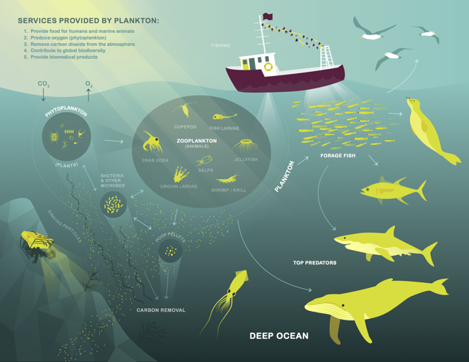
Introduction -- Kaggle Competition
“ Identify images of 121 species of plankton,
and calculate the probability of each species. ”
Notes:
我們這組找到Kaggle上的比賽，這個比賽的主要目標是：辨識121種浮游生物的圖像，並算出他屬於各類別的機率。
他的資料集總共有130400（13萬4百）張圖片，其中的3萬張有標籤，可作為訓練集或是驗證集，其餘的圖像則是測試集，要算出每張圖片屬於各個類別的機率，並上傳Kaggle。

Slide 5
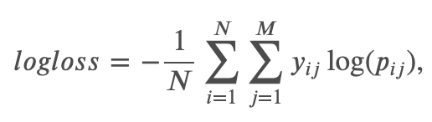
Evaluation
Image | Class 1 | Class 2 | ...... | Class 121
Image1.jpg | 0.01 | 0.03 | ...... | 0.09
Image2.jpg | 0.05 | -0.01 | ...... | 0.02
Notes:
這個比賽需要上傳的是對於每一張圖片，它可能是每一個類別的機率，機率總和可以不是1，並計算Log-Loss。

Slide 6
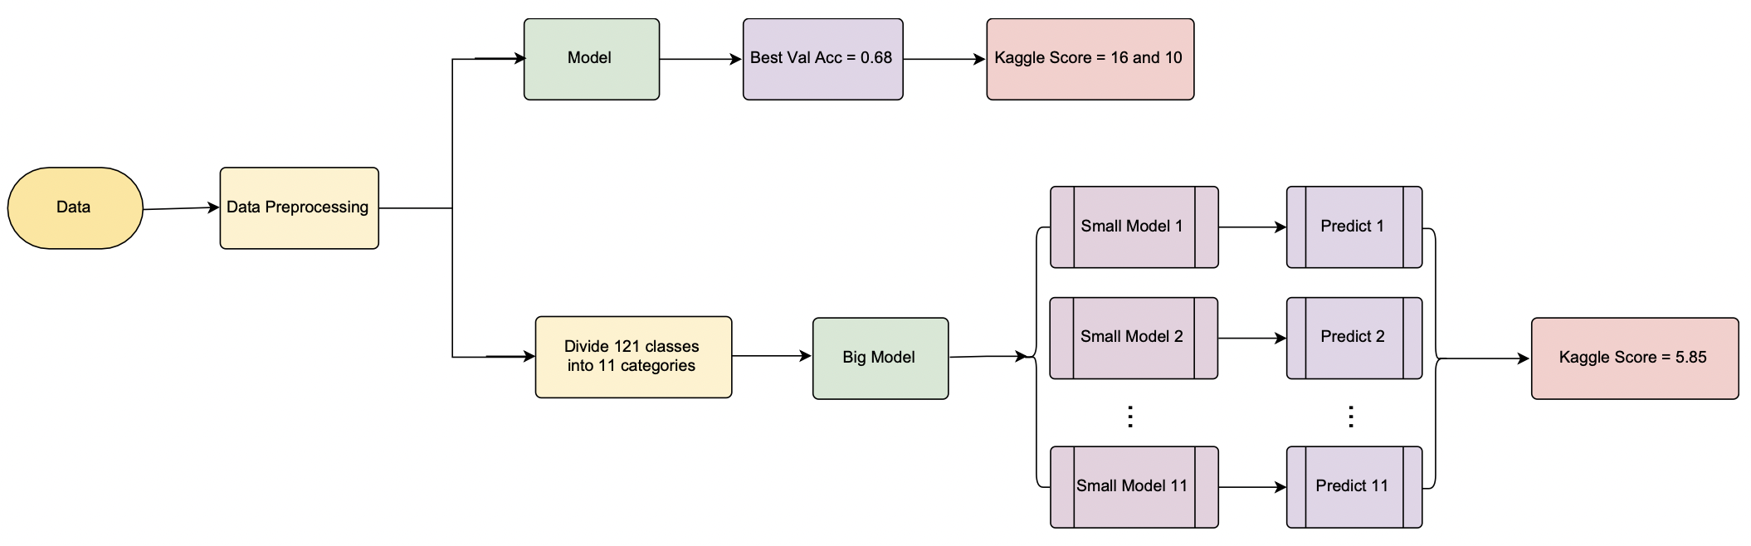
Flow Chart
Notes:
首先我們先進行資料前處理，再開始建立模型。
第一個遇到的問題是，浮游生物的種類太多了，有121種，我們擔心一個模型會分類得不夠好，因此想了兩種方法實驗哪個方式較優。
那第一種方法就是直接建立模型，我們總共建立了5個CNN模型，以有最好的驗證正確率的這個ResNet152模型，去預測測試集的圖像類別，丟到Kaggle上有16和10的成績，當然，Log Loss是越低越好。
第二種方式是先將121種浮游生物分為11大類，先建立一個大的模型，將圖片分成11類，再分別建立11個小的模型並預測圖片是屬於121種生物中的哪一個類別。像是分成兩階段的做分類。而這種做法丟到Kaggle上，有5.85的成績，比第一種方法的成績好。

Slide 7
Data Preprocessing and Splitting
2

Slide 8
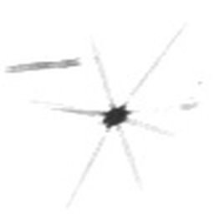
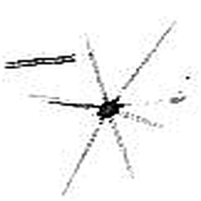
Data Preprocessing and Splitting
The datasets is monochromic image -> change 1 layer to 3 layer
Enhance the edges with `ImageFilter.EDGE_ENHANCE_MORE` in PIL package
Resize to (256,256)
Split Training set (n=24322) and
Val set(n = 6014) with 80/20 principal,
Test set(n=130400)
Before
After

Slide 9
Models
3

Slide 10
Model
Model | Optimizer | Learning Rate | Best Accuracy
CNN-1 | SGD (momentum = 0.9) | 10^-2 | 0.55
CNN-2 | Adam (betas=(0.9, 0.999)) | 10^-5 | 0.65
CNN-2 | SGD (momentum = 0.8) | 10^-4 | 0.51
ResNet34 (pretrained = False) | SGD (momentum = 0.9) | 10^-2 | 0.63
ResNet152 (pretrained = False) | SGD (momentum = 0.9) | 10^-2 | 0.68
Kaggle Score: 10.88

Slide 11
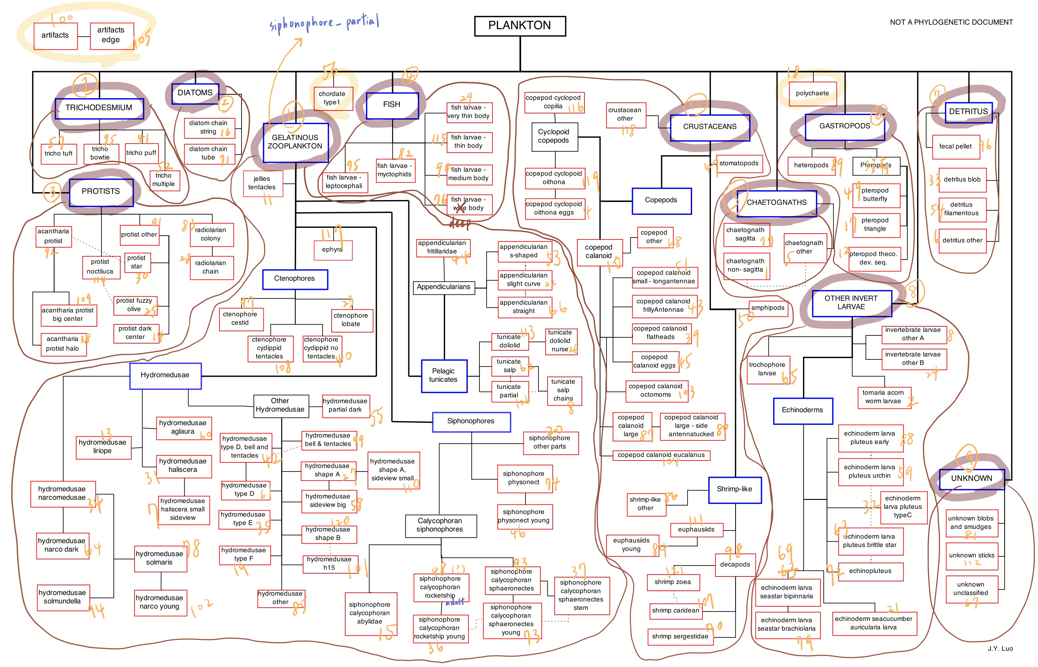

Slide 12
Big Model -> Small Model
Big Model
Split all Classes to 11 Categories in train set and validation set.
file_path | images_category | label | label_11 | label2
protist_star_90.jpg | protist_star | 30 | protists | 3
protist_star_78.jpg | protist_star | 30 | protists | 3
⋯ | ⋯ | ⋯ | ⋯ | ⋯
artifacts_399.jpg | artifacts | 100 | unknown | 9
artifacts_197.jpg | artifacts | 100 | unknown | 9
⋯ | ⋯ | ⋯ | ⋯ | ⋯
hydromedusae_other_117.jpg | hydromedusae_other | 85 | gelatinous_zooplankton | 11
hydromedusae_other_115.jpg | hydromedusae_other | 85 | gelatinous_zooplankton | 11
⋯ | ⋯ | ⋯ | ⋯ | ⋯
copepod_calanoid_1097.jpg | copepod_calanoid | 10 | crustaceans | 10
copepod_calanoid_639.jpg | copepod_calanoid | 10 | crustaceans | 10

Slide 13
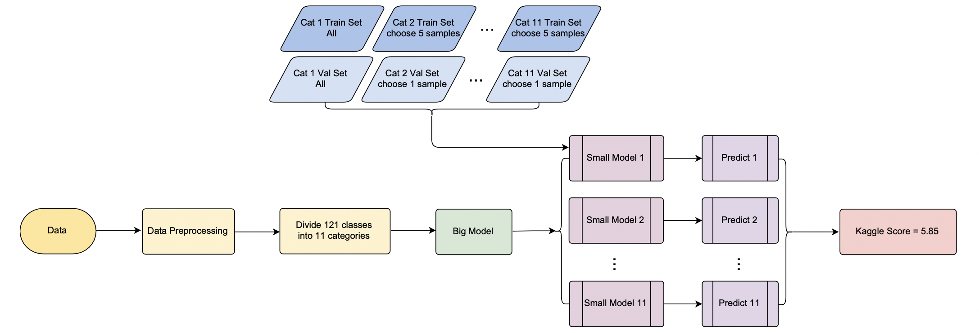
Big Model -> Small Model -- Flow Chart

Slide 14
Big Model -> Small Model
Take 1st small model for example:
Train Set
Get all training images in 1st Category, and randomly pick up 5 images in the rest of classes
Validation Set
Get all validation images in 1st Category, and randomly pick up 1 image in the rest of classes
Test Set
All test images predicted as 1st Category

Slide 15
Comparison
Model | Kaggle Score
Model (ResNet152) | 10.88
Big Model -> Small Model (ResNet152) -> (ResNet152) | 5.85
Depends on the accuracy of big model

Slide 16
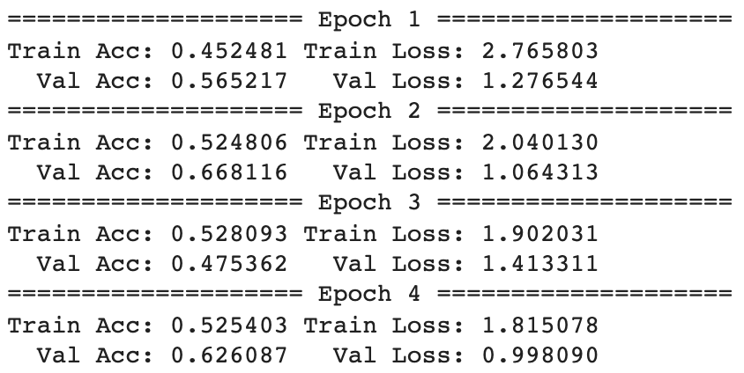
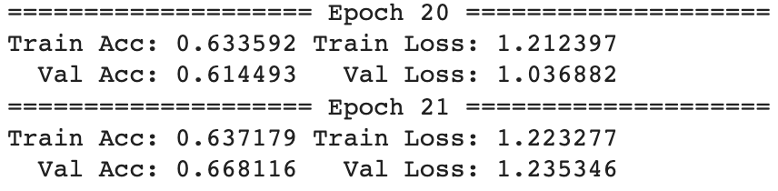
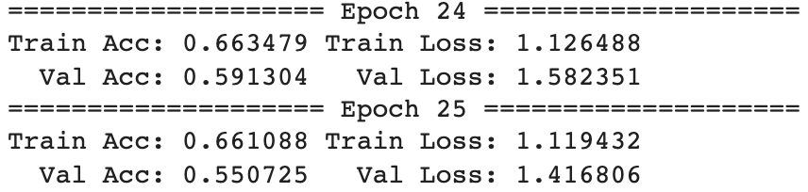
New Findings in Small Model Training
Val Acc < Training Acc in the beginning of the training
Sometimes accuracy improves, but log loss does not

Slide 17
Insight and Future Work
5

Slide 18
Insight and Future Work
Apply Semi-supervised Learning method.
Whether plankton unrelated to other species be included in the category of unknown species
2
4
1
3
After being divided into 11 categories, the amount of data in each category is unbalanced.
Categories with too many species can be subdivided.
The way to form a new training set
and validation set.

Slide 20
THANKS!
THANKS!

